Slide 1
“A Brief Introduction to OpenMusicTheory.com Version 2” Lightning Talk 2021 College Music Society South Central Regional Conference (Virtual) Mar. 26–28, 2021
Dr. Kyle Gullings, D.M.A.
Director of The School of Performing Arts
Associate Professor of Music Theory & Composition
The University of Texas at Tyler
kgullings@uttyler.edu
Licensed under a Creative Commons Attribution-ShareAlike 4.0 International License.

Slide 2
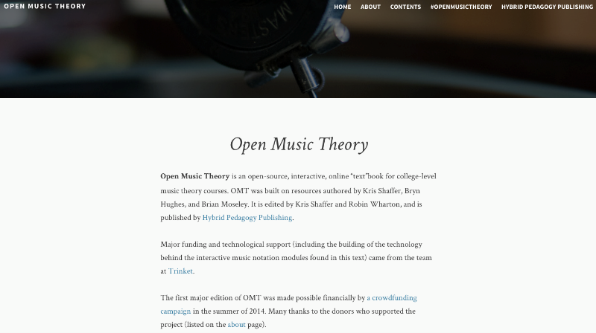
Open Music Theory v.1
Open Music Theory, Version 1:
http://openmusictheory.com/. Licensed under CC BY-SA 4.0

Slide 3
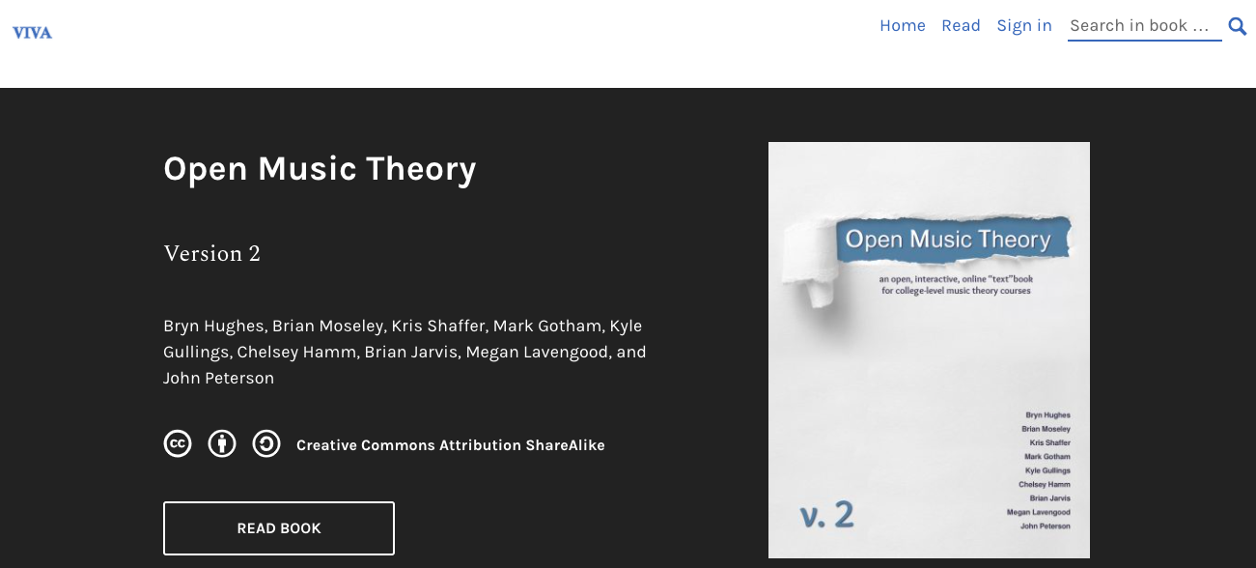
Open Music Theory v.2
Open Music Theory, Version 2:
https://viva.pressbooks.pub/openmusictheory/. Licensed under CC BY-SA 4.0

Slide 4
Projected Cost Savings
$ 200.10 Saved per student
x 1,269 Students (6 institutions)
= $253,922.05 Projected Savings for 2020–2021
$ 253,922.05 Projected Annual Savings
÷ 6 Institutions (2020–2021)
x 640 NASM institutions in the U.S.
= $27,085,018.67 Potential Annual Savings

Slide 5
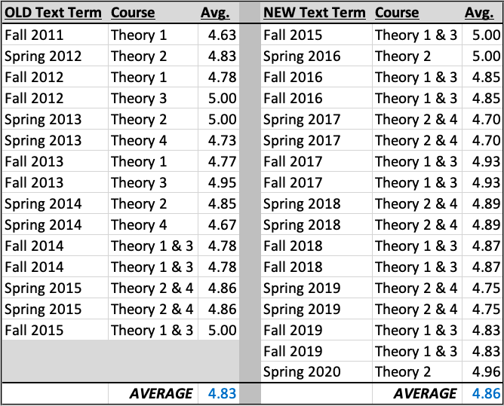
Efficacy: Course Evaluations

Slide 6
Efficacy: Semester Grades
Average semester grades, Music Theory III
Old Text, Fall 2015: 81.59%
New Text OMT, Fall 2016: 82.74%

Slide 7
OER Efficacy and Perceptions
John Hilton III (2016):
“[…] OER are comparable in quality to traditional learning resources […]”
“[…] the use of OER does not appear to negatively influence student learning […]”
Hilton III, John. “Open Educational Resources and College Textbook Choices: A Review of Research on Efficacy and Perceptions,” Education Tech Research Dev (2016) 64: 573. doi:10.1007/s11423-016-9434-9. http://rdcu.be/s6Gx.

Slide 8
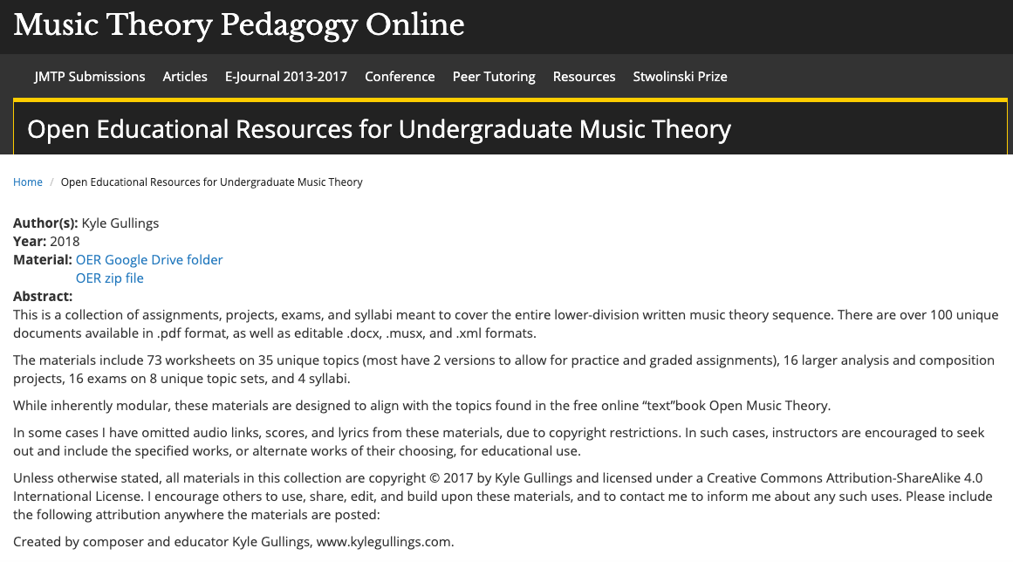
OMT Challenges: No Workbook
Open Educational Resources for Undergraduate Music Theory:
https://jmtp.appstate.edu/open-educational-resources-undergraduate-music-theory. Licensed under CC BY-SA 4.0

Slide 9
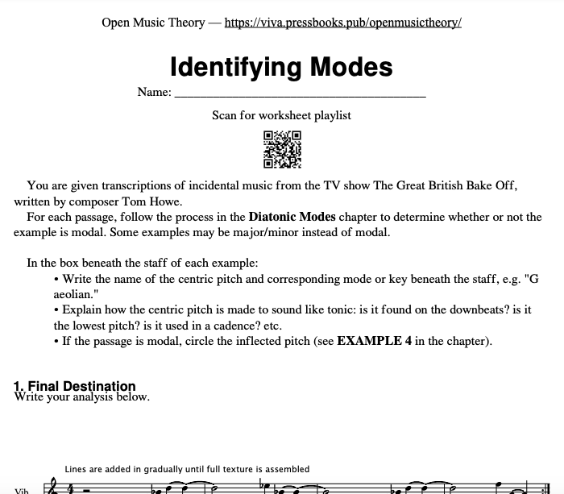
OMT Challenges: No Workbook
Open Music Theory, Version 2. “Identifying Modes”:
https://viva.pressbooks.pub/app/uploads/sites/12/2020/02/WK-modes.pdf. Licensed under CC BY-SA 4.0

Slide 10
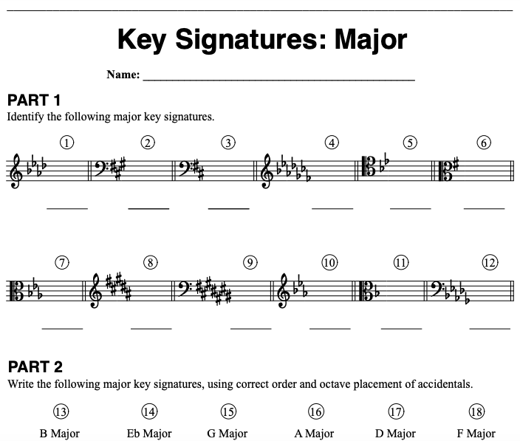
OMT Challenges: No Workbook
Open Music Theory, Version 2. “Key Signatures: Major”:
https://viva.pressbooks.pub/app/uploads/sites/12/2019/05/WK-Key-Signatures-Major.pdf. Licensed under CC BY-SA 4.0

Slide 11
OMT Challenges: No Workbook
Open Music Theory, Version 2. “Major Scales, Scale Degrees, and Key Signatures”:
https://viva.pressbooks.pub/openmusictheory/chapter/scales-and-scale-degrees/. Licensed under CC BY-SA 4.0

Slide 12
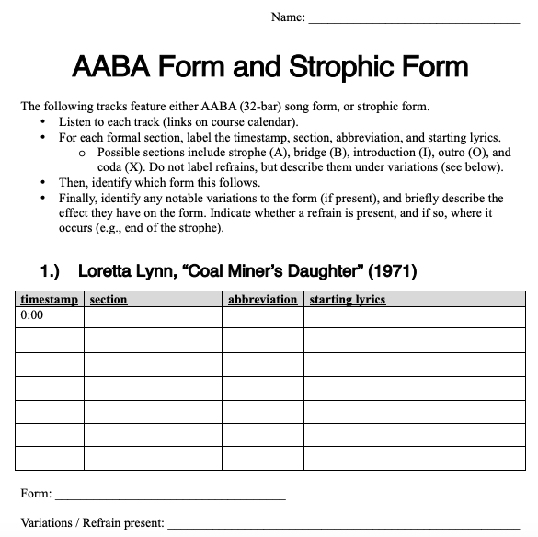
OMT Challenges: No Workbook
Open Music Theory, Version 2. “AABA and Strophic Form”:
https://viva.pressbooks.pub/app/uploads/sites/12/2019/08/WK-AABA-and-strophic-forms.pdf. Licensed under CC BY-SA 4.0

Slide 13
OMT Challenges
Additional Challenges:
Comprehensiveness and depth of topics
Curricular sequencing

Slide 14
Curricular Redesign Resources
Lavengood, Megan L. “Bespoke Music Theory: A Modular Core Curriculum Designed for Audio Engineers, Classical Violinists, and Everyone in Between.” Engaging Students: Essays in Music Pedagogy 7 (2020). https://doi.org/10.18061/es.v7i0.7362.
Lavengood, Megan. “Not Just a Theory: How to Put an Egalitarian Music Theory Curriculum into Practice." Society for Music Theory Virtual Conference 2020. https://guide.societymusictheory.org/sessions/nov15/morning/using-open-educational-resources.

Slide 15
A Confession…

Slide 16
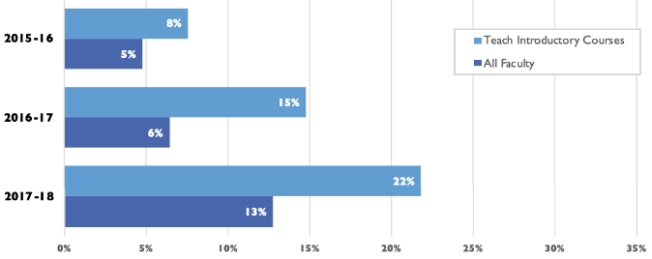
Context: Use of OER
Faculty Use of OER as Required Material in Any Course, 2015–16 to 2017–18
Babson Survey Research Group, Opening the Textbook: Open Education Resources in U.S. Higher Education, 2018:
http://www.onlinelearningsurvey.com/reports/freeingthetextbook2018.pdf. Licensed under CC BY 4.0.

Slide 17
“A Brief Introduction to OpenMusicTheory.com Version 2” Lightning Talk 2021 College Music Society South Central Regional Conference (Virtual) Mar. 26–28, 2021
Dr. Kyle Gullings, D.M.A.
Director of The School of Performing Arts
Associate Professor of Music Theory & Composition
The University of Texas at Tyler
kgullings@uttyler.edu
Licensed under a Creative Commons Attribution-ShareAlike 4.0 International License.

